Slide 1
Azure Stack
Lessons learned from use in the real world

Slide 2





Rik Hepworth
Chief Consulting Officer, Black Marble
MVP (Azure)
@rikhepworth
github.com/rikhepworth
blogs.blackmarble.co.uk

Slide 4
What is Azure Stack
‘Cloud consistent’ appliance for organisations and hosting providers to extend Azure services into the datacentre
Aimed at key scenarios:
Data that can’t leave our org
Latency requirements the cloud can’t deliver
Disconnected or intermittently connected
All with the need for a consistent dev model with Azure
Monthly update cadence

Slide 5
What’s ‘in the box’?
A subset of Resource Providers:
Storage
Network
Compute
KeyVault
Marketplace offerings can be downloaded
App Services is a post-install deployment
Websites, WebJobs, Functions

Slide 6
Stack In Production
Work with the Vendor to size your Stack
Four, eight, twelve and sixteen nodes
Who are the users?
Consumers of services, just like with Azure
Who are the operators?
Manage the Stack and choose what services to offer
Break-glass approach to management and support
Vendor and Microsoft provide support

Slide 7
There’s no substitute for Stack
An unsupported SDK will still work in Azure
Even if you configure your sub to limit available APIs
Performance is different
Under the hood Stack is on Windows Server
If you’re not using AAD authentication issues will kill you

Slide 8
Not much ‘Dev’ in the ASDK
Install into a ‘bubble’
RDP to host or VPN to do stuff
Nearly impossible to:
Share
Connect to DevOps tooling e.g. Azure DevOps Pipelines
Manage
All eval media, so expires after 180 days
No upgrade – rip and replace each month to keep current

Slide 9
What we do for Dev
Modified approach to install for repeatability
Still changes monthly with new releases!
Exploit System Centre to easily re-image the host
Modify the install config and script to sit on our network
Use Matt McSpirit’s ConfigASDK script to configure post install
Try to rebuild over the weekend
Even with automation there’s 24 hours of downtime

Slide 10
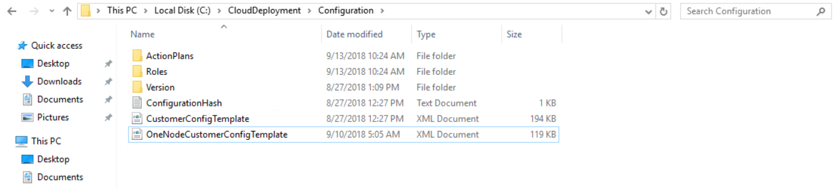
Sitting on our network - IP
Our network is a /8 subnetted with /16 subnets
ASDK Host gets IP on our main subnet
Allocate a /16 subnet for the Stack and configure our router
XML Config file – replace 192.168. with a /16 address space

Slide 11
Sitting on our network - IP
Post install use RemoveNat.ps1 script
Ensure our router has the IP of the gateway to route into the ASDK subnet

Slide 12
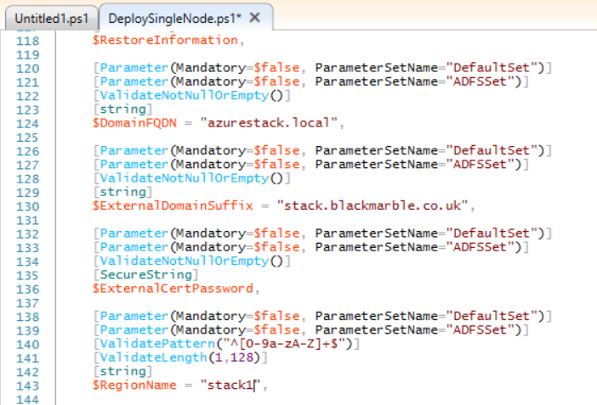
Sitting on our network - DNS
If you only need one, you could stop here
Set up conditional forwarders
Local.azurestack.external
Local.cloudapp.azurestack.external
But, we use DirectAccess and I need multiple stacks
Edit the installation script (!)

Slide 13
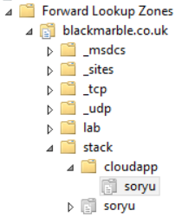
Sitting on our network - DNS
Create HOST record for DNS in stack
X.X.200.67
Configure delegation in DNS
Set the NS to the HOST
2 needed:
<region>
<region>.cloudapp
both under your chosen subdomain

Slide 14
Our experience: positive
The customer solution was much easier with Stack
They have an option to scale out to Azure if constraints change
Multi-org collaboration was easier than other on-premises projects
Time to deliver was quicker than without Stack

Slide 15
Our experience: negative
Stack is still young
Monthly updates can hinder not help
Stack in production is not quite update whilst live yet
Customer plans to have several stacks for this solution
The ‘D’ in ASDK should be demo not dev
Azure is no substitute for Stack right now
Limited Resource Provider constrains design

Slide 16
Conclusions
Is Stack for you?
It depends
Is Stack ‘cloud consistent’?
Mostly
Is the ASDK useful ‘out of the box’?
Not unless you just want to play
Is this approach the future?
Almost certainly!

Slide 17
Useful Links
ConfigASDK (@mattmcspirit)
https://github.com/mattmcspirit
Azurestack Blog
https://azurestack.blog/
@rikhepworth
github.com/rikhepworth
blogs.blackmarble.co.uk

